Slide 1

Mood Nation
See What’s the mood of the nation @ National Elections 2k14

Slide 2

Problems we’re trying to solve
Vast discussion on national elections in social media channels
Political data distributed across the web and no quick and easy way to see aggregated info
Absence of a platform to track public sentiments on elections

Slide 3
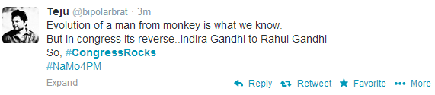
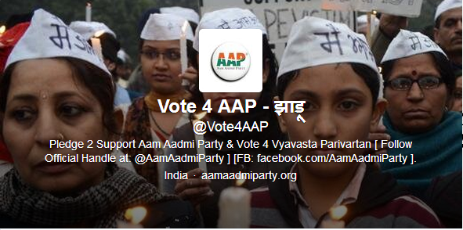
Our Solution
Using Twitter as a medium for gathering social media data

Slide 4

Our Solution
Use Twitter as a platform to grab social media data
Aggregate the distributed data and Get meaningful information out of it
Tapping on critic opinions and opinions of twitter junta on political parties
Sentimental Analysis to segregate positive negative tweets on social media data

Slide 5





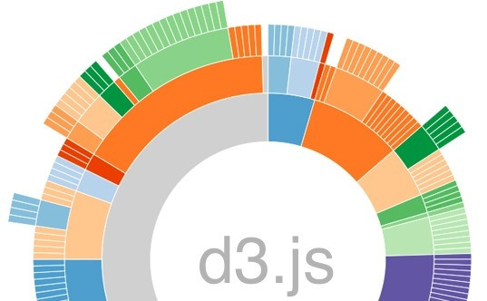

Tech Details

Slide 6
DEMO
QnA

